Slide 1
CS3530 - Computer Networks 1
WEB SERVER CLIENT
Guntreddi Venkata Surya Sai CS19BTECH11014
Malthi Sai Vardhan MA19BTECH11010
K Satya Sandesh MA19BTECH11008
Routhu Prashanth CS19BTECH11042
S. Bhanu Prakash CS19BTECH11037
Samatham Manish Krishna MA19BTECH11004

Slide 2
Software Overview
The system is based on the client-server architecture using socket programming.
The basic outline is communication of information between client and server through network socket.
We used TCP protocol in the making of the web server.
Our web server functionality is primely uploading and downloading of files of multiple formats

Slide 3
Server Protocol (Control Flow)
create_socket()
bind() ----- binds address (hostname, port number pair) to socket
listen() --- waiting for client to connect
accept()----- when client asks for connection and types right password
recv() ----- when client requests something receive it
send() ----- sends the requested thing to client
Loop from 3

Slide 4
Client Protocol (Control Flow)
socket()
connect() ----- to the server
send() ----- send request to the server
recv() ----- receive the information asked to the server
exit

Slide 5
ILLUSTRATION OF CLIENT AND SINGLE SERVER CONTROL FLOW.
Similar thing happens with multiple clients.
The numbers in the boxes mean:
1. Requests Connection.
2. Asks Password
3. Types Password
4. If right password,the thing client asks for is given by the server.
1.
1. SERVER
Sets up socket and starts listening
2
3
In the step 3, if client enters wrong password again step 2 is repeated (happens upto 5 incorrect password trials)
CLIENT
4
5. Request Service
6.Services the request.

Slide 6
FEATURES INCLUDED:
ls:- By invoking this command in the client process, the files present in the server are listed.
upload:- By invoking the command, the client uploads a file to the server.
download:- By invoking this command, in the client process it requests the file (whose name is typed after load command) and downloads it from the server.
feedback:- By invoking this command, the client can give feedback to the server.
exit:- By invoking this command, the client process gets finished.

Slide 7
Salient features
The server can handle multiple clients concurrently.
The server can handle multiple file formats like .pdf, .txt, .ppt, .csv, .zip, .odt etc.
Even large files (size of order mbs) can be sent successfully by breaking them into packets.
The connection is encrypted which means only those clients who the enter right password are allowed to interact with the server.

Slide 8
The big picture of the Algorithm
Server and client set up their TCP socket by binding by PORT and IP_ADDR.
Server process starts and keeps listening indefinitely. For each client, a separate thread will be created after the connection is established by right password. Only the clients who enter the right password are allowed to interact with the server.
Client sends request for server in the form of the 4 basic commands which are ls, download, upload, feedback.
The files to be transferred are encoded and then broken into chunks of 1024 bytes during the transfer.
Once the client is done asking for services it can quit by using exit command.

Slide 9
Implementation details in Python
The functions used are: (related to socket programming)
socket.gethostname() which returns the hostname of current system
gethostbyname() returns ip_address of host
bind():- Assigns ip_address and port name to socket instance. The client need not bind.
connect():- to establish a handshake mechanism with the server socket- used in client code typically.

Slide 10
Implementation details(Continued..)
recv() method with argument as size - used to data on both connectionless and connection-oriented sockets.
send() method with argument as length used to send data from one socket to another.
socket(socket.AF_INET, socket.SOCK_STREAM) where AF_NET refers to address family ipv4 and SOCK_STREAM means connection oriented TCP.
The rest of the program is handling of requests case by case.

Slide 11
WORKING ILLUSTRATIONS
(loading…)

Slide 12
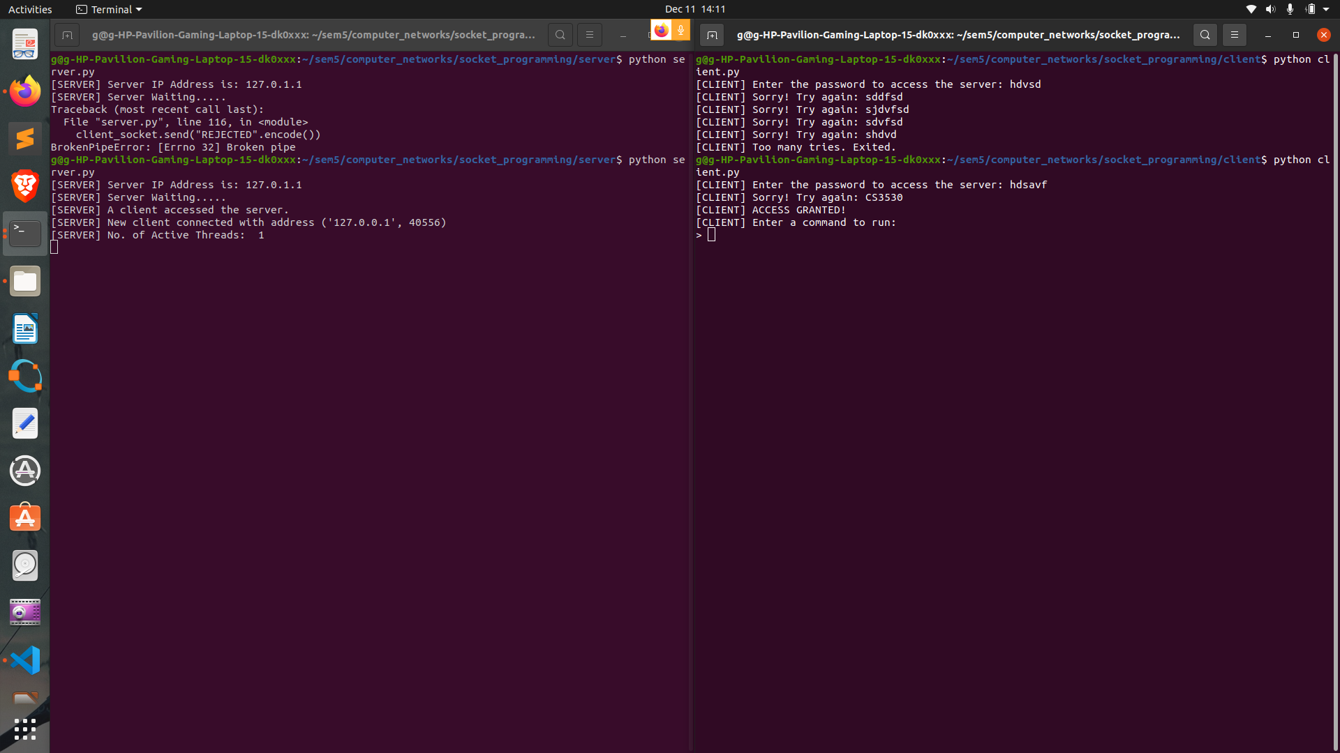
Password encryption:

Slide 13
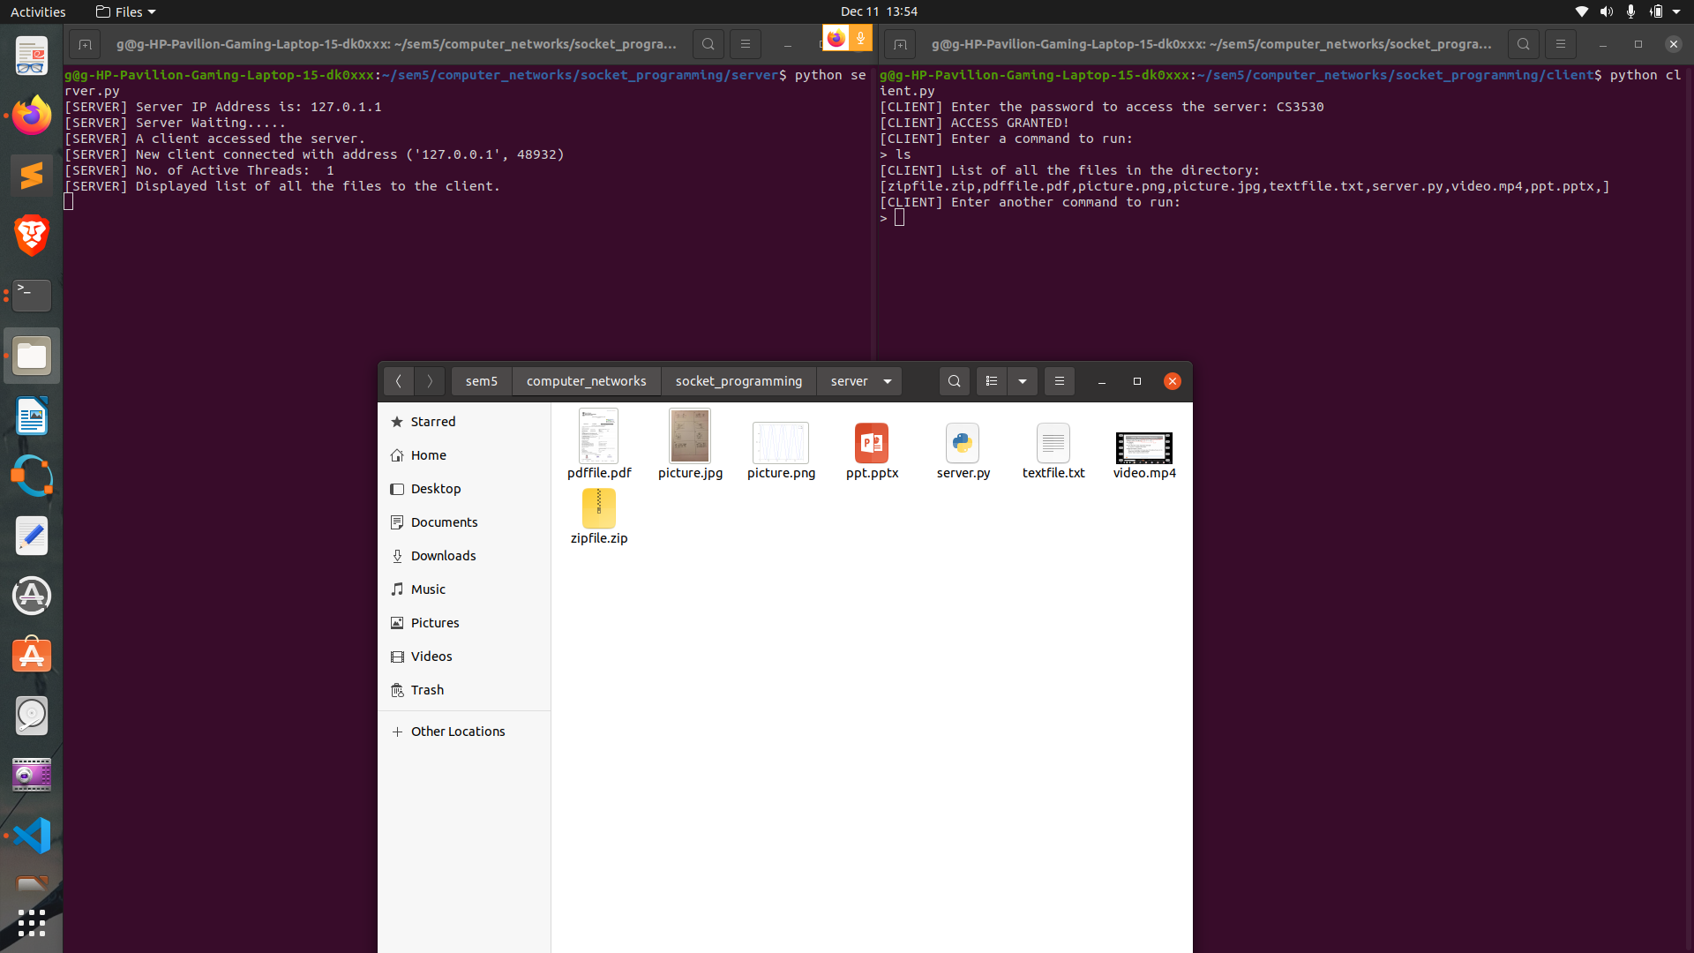
ls

Slide 14
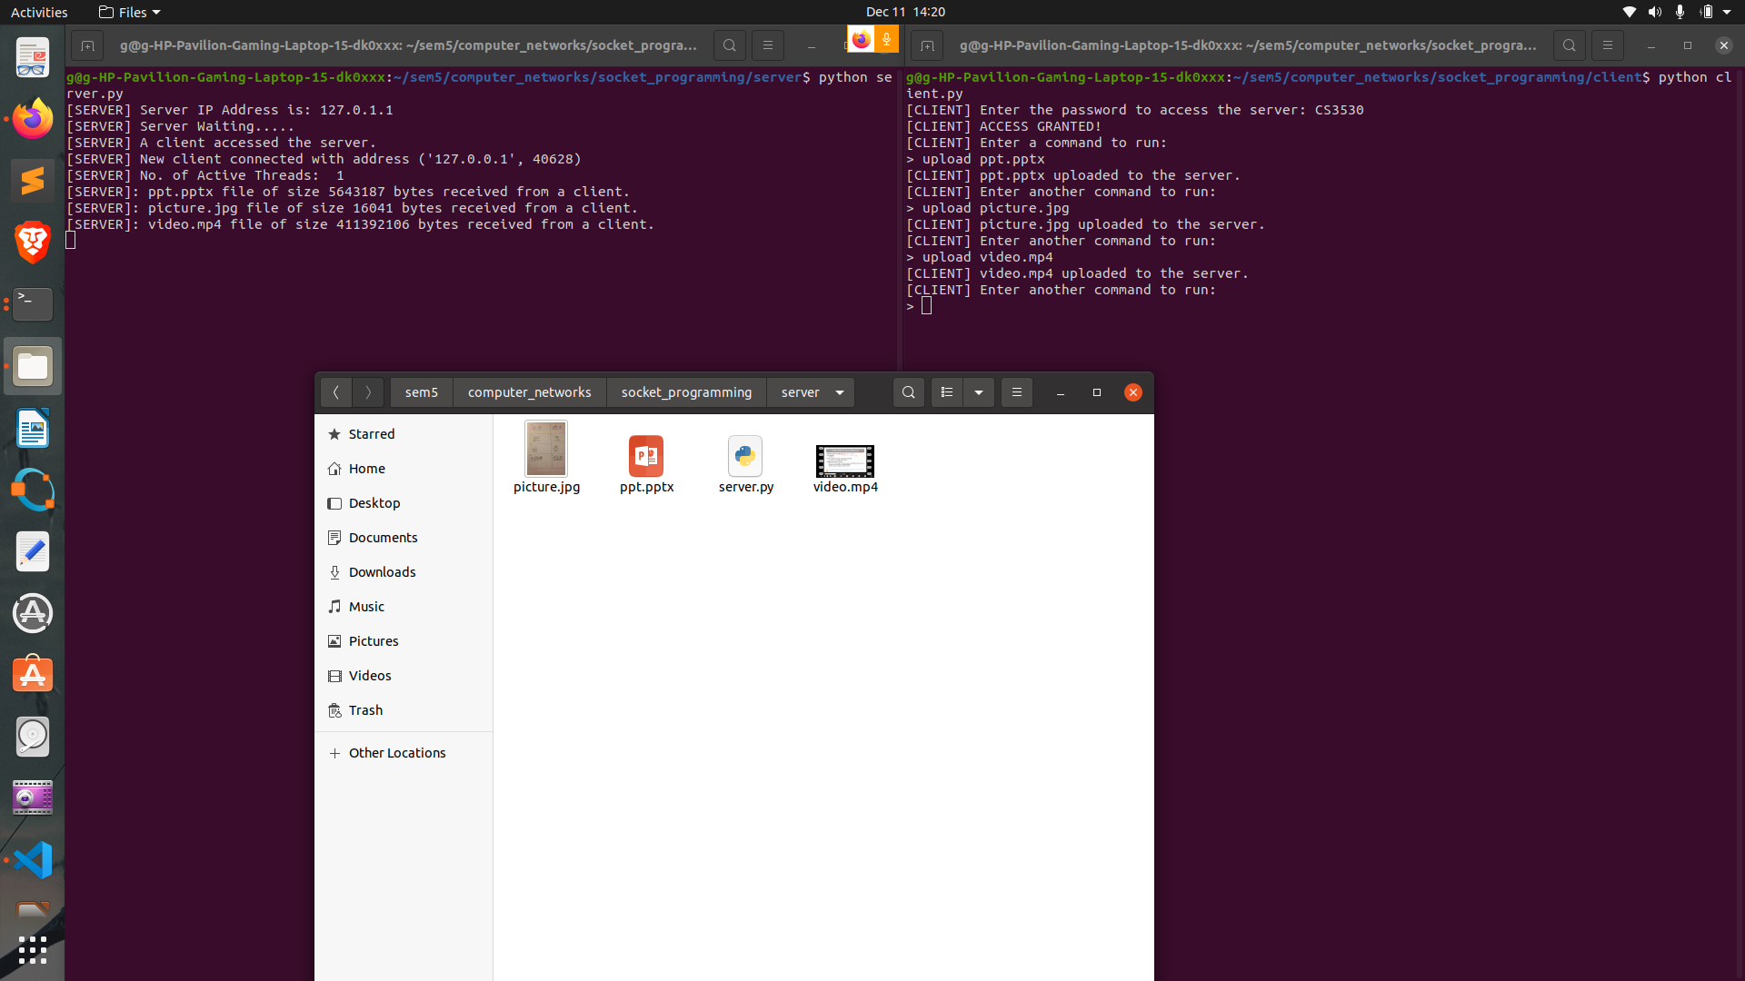
upload

Slide 15
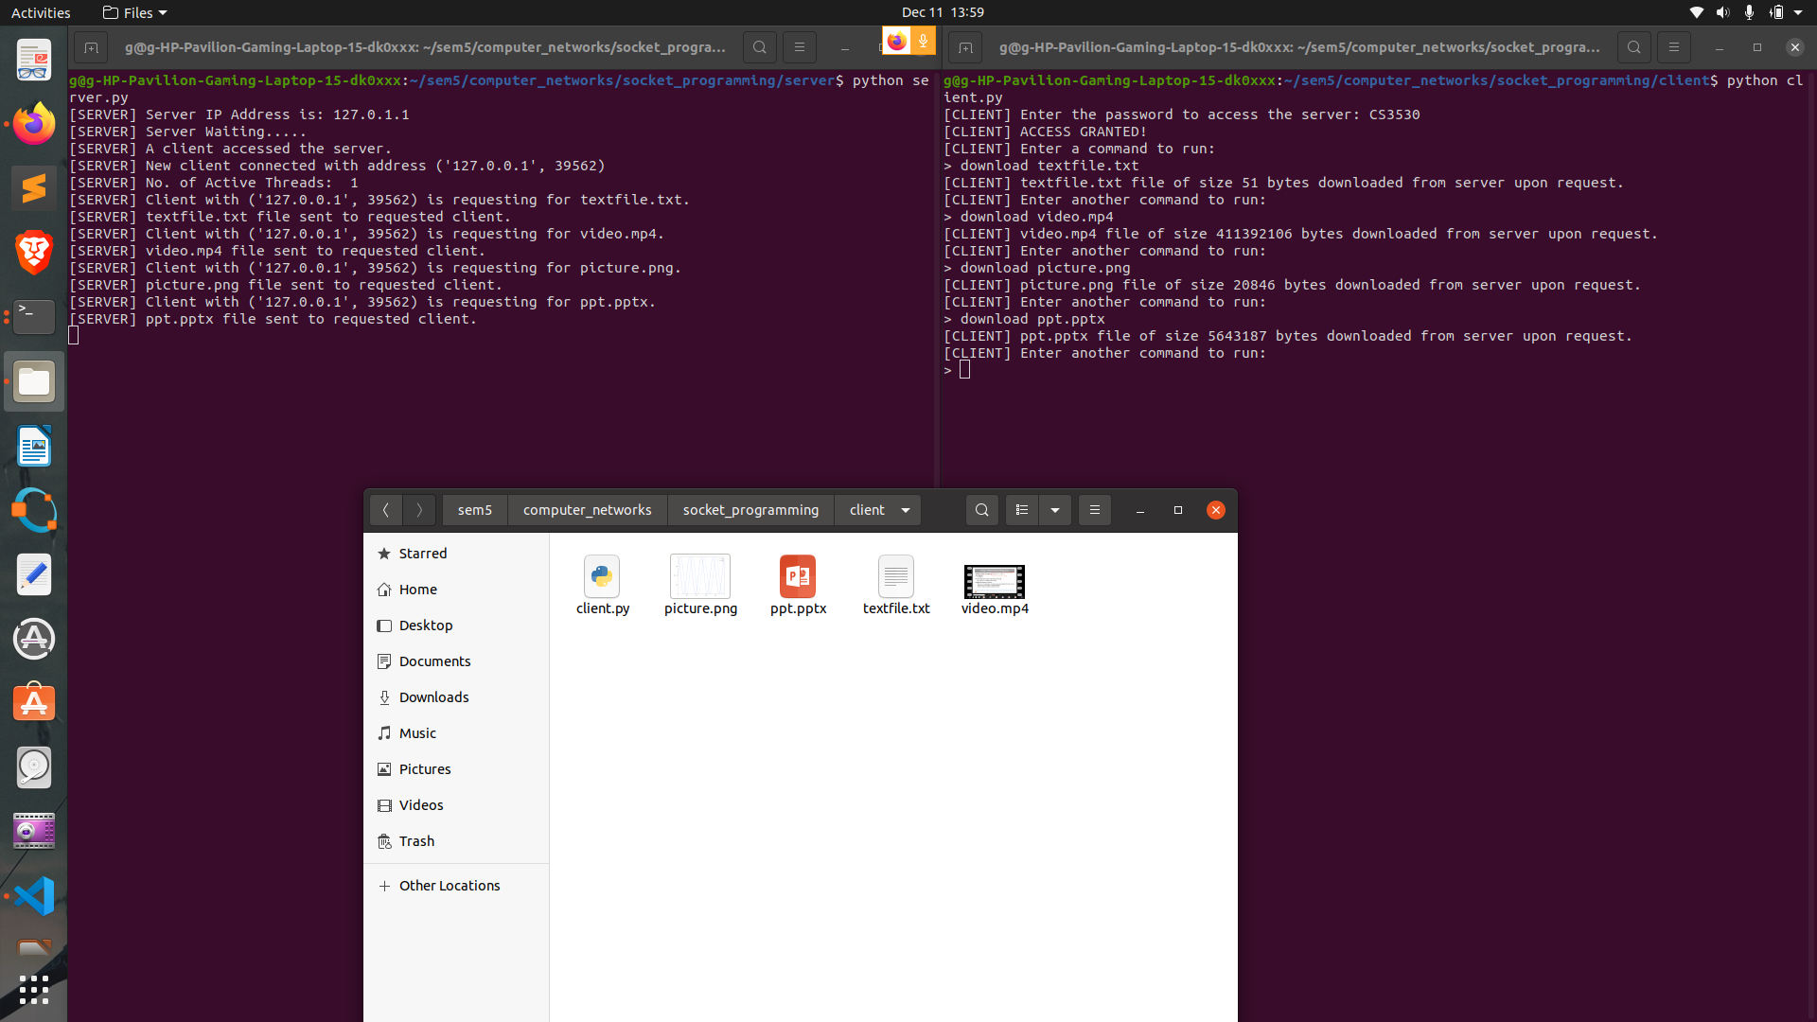
download

Slide 16
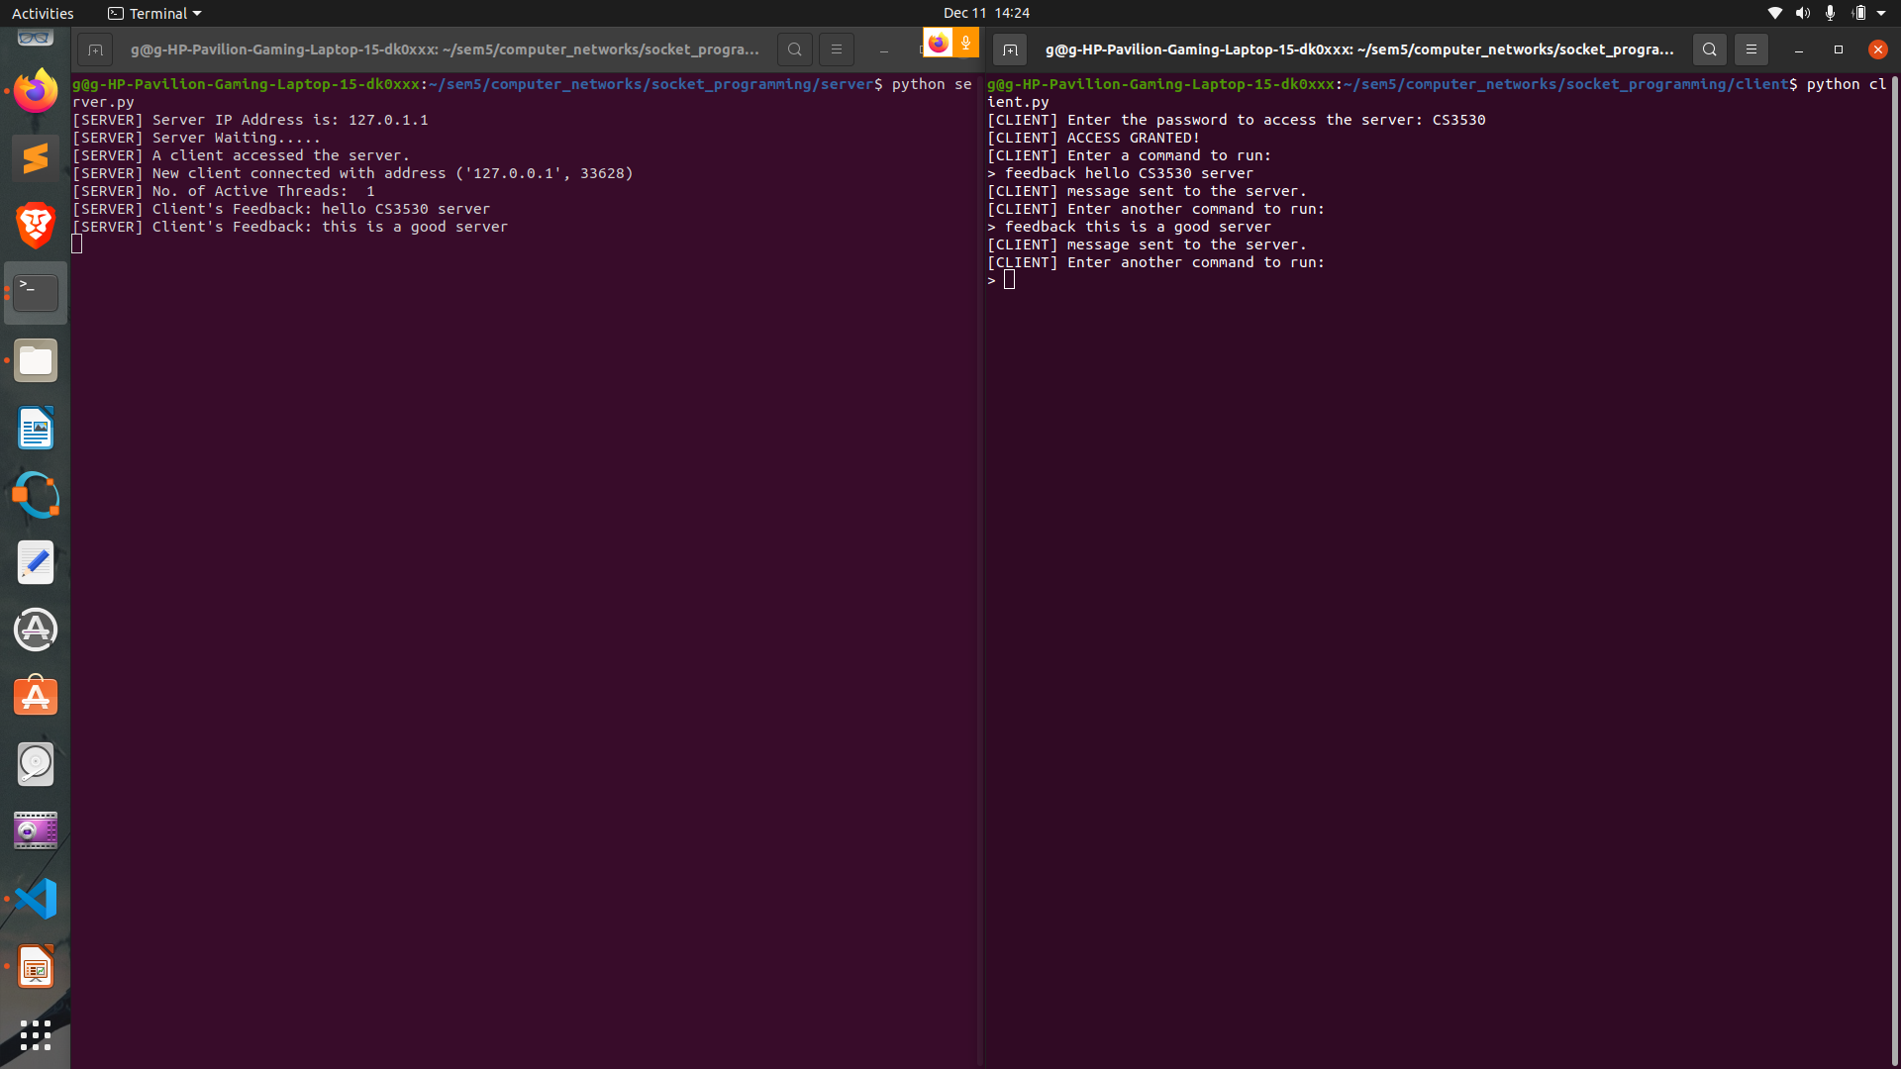
feedback

Slide 17
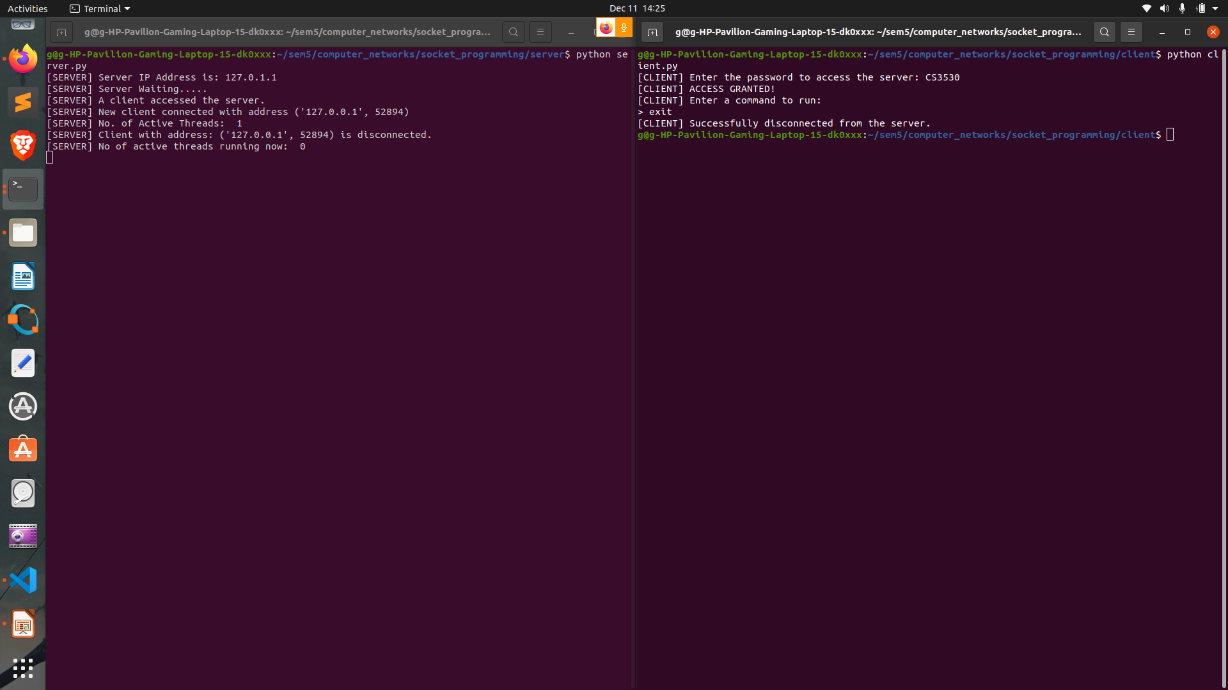
exit

Slide 18
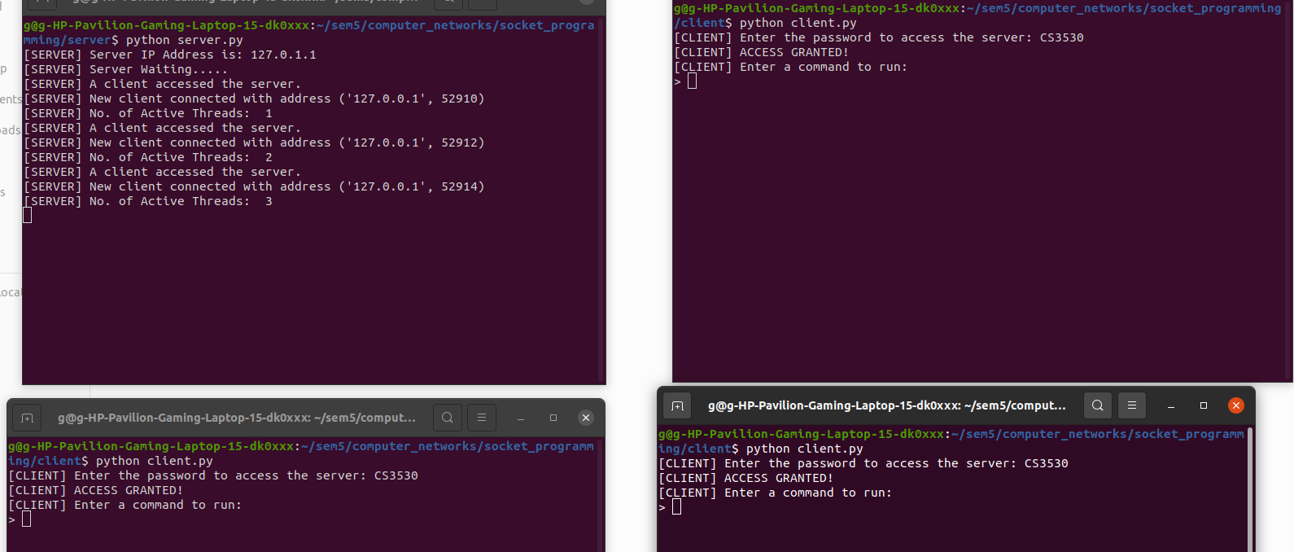
Multi-client illustration

Slide 19
THANK YOU...

